Slide 1



LOB Calculations as per
My Success Plan

Slide 2
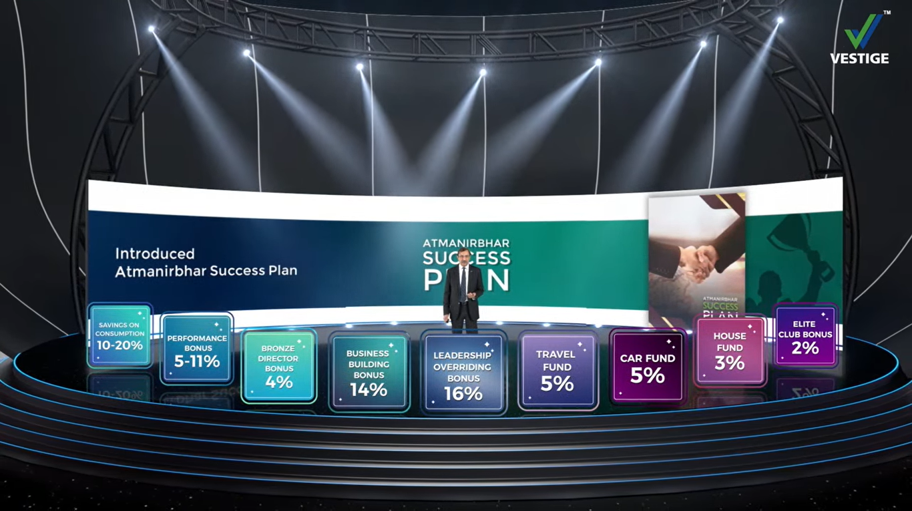

MY SUCCESS PLAN
TBB
Team Building Bonus
3%
3%
15%
Applicable from January 2022 Onward

Slide 3
Full Form of Short Term used in Vestige Plan
Short Terms | Full Form of Short Terms | Meaning of the Term
PV | Point Value | Every purchase count in PV and multiply by Rs. 30/- (average) comes total sales
BV | Business Volume | Our turn over count 60% of our total sales is called BV (Rs. 30/-@60% = 18 BV)
SP | Self Purchase | Below Bronze Dir need 20 PPV / Bronze Dir & above need 40 PPV for Cheques
SV | Side Volume | Non qualify Bronze Dir and below legs PV is count as Side PV (Level Maintenance)
PPV | Personal Volume | Your purchase done on your own ID is count as PPV
GPV | Group Volume | Volume done by your complete team except you PPV is called GPV
DB | Director Bonus | Qualified Bronze Directors can avail 4% DB Income
BBB | Business Building Bonus | Qualified Silver Directors and up leaders can avail 14% BBB Income
TBB | Team Building Bonus | Qualified Bronze (2600 GPV) & Silver (2100 SV) can avail 2% TBB (up to Crown)
LOB | Leadership Overriding Bonus | Qualified Silver Director (5625 PV in one qualify group) & up can avail LOB Income
PB | Performance Bonus | Income on our self purchase & %age difference between you legs (5% to 11%)
TF | Travel Fund | Qualified Gold Director and up can avail 3% TF Income
CF | Car Fund (Up to 80K/PM) | Qualified Star Dir for continue 3 months can avail 5% CF life time (min Silver req.)
HF | House Fund (Up to 1L/PM) | Qualified Crown Dir for continue 3 months can avail 3% HF life time (min Silver req)
ECB | Elite Class Bonus (Up to 20L) | Qualified Universal Crown Director and up can avail 2% ECB Income

Slide 4
Total 9 Levels are in Vestige Marketing
Status | Director Groups | Qualifying Conditions
 |  | Self Purchase | Side Volume
Bronze Director | - | SP 40 PV | 5500 PV total or 4500 PV in 1 business month
Silver Director | 1 | SP 40 PV | 1801 PV
Gold Director | 2 | SP 40 PV | 1501 PV
Star Director | 3 | SP 40 PV | 1001 PV
Diamond Director | 4 | SP 40 PV | 501 PV
Crown Director | 6 | SP 40 PV | ---
Universal Crown Director | 8 | SP 40 PV | ---
Double Crown Director | 12 | SP 40 PV | ---
Double Universal Crown Director | 16 | SP 40 PV | ---

Slide 5
Calculation of Director Bonus Points
Status | Director Groups | Qualifying Conditions | QUALIFIED DIRECTOR LEVEL IN %
 |  |  | You | 1 | 2 | 3 | 4 | 5 | 6 | 7 | 8 | 9
Silver Director | 1 | SP 40 PV : 1801 PV | 6 | 5 | 4
Gold Director | 2 | SP 40 PV : 1501 PV | 6 | 5 | 4 | 3
Star Director | 3 | SP 40 PV : 1001 PV | 6 | 5 | 4 | 3 | 2
Diamond Director | 4 | SP 40 PV: 501 PV | 6 | 5 | 4 | 3 | 2 | 1
Crown Director | 6 | SP 40 PV | 6 | 5 | 4 | 3 | 2 | 1 | 0.5
Universal Crown Director | 8 | SP 40 PV | 6 | 5 | 4 | 3 | 2 | 1 | 0.5 | 0.5
Double Crown Director | 12 | SP 40 PV | 6 | 5 | 4 | 3 | 2 | 1 | 0.5 | 0.5 | 0.5
Double Universal Crown Director | 16 | SP 40 PV | 6 | 5 | 4 | 3 | 2 | 1 | 0.5 | 0.5 | 0.5 | 0.5
Example:
Qualified Silver Director
A
2100 PV x 6%
= 126x18 = 2268
Silver Director
B
1801 PV x 5%
= 90x18 = 1620
Bronze Director
C
6000 PV x 4%
= 240x18 = 4320
Total = 8208 DB Points
1 PV = Rs. 30/- Take 60% of PV Value = Rs. 18/ (BV) to calculate your turnover

Slide 6
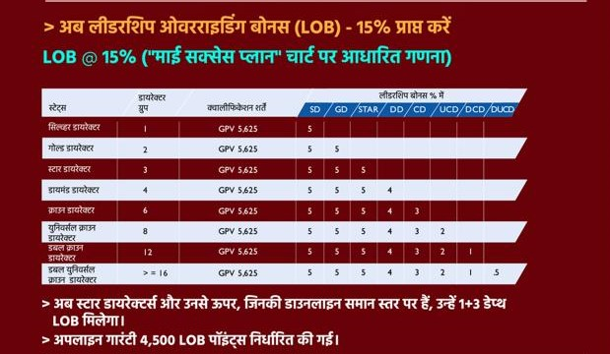
Calculation of LOB Bonus Points
Important Notes: -
Multiple LOB will be start from Gold Director Level
4500 LOB Points decided for Upline Guarantee
Star & above Uplines has to maintain at least same level or above level from his downline for taking multiple LOB.
Side Volume will be counted for LOB @5%
LOB Point Value will be increased from Rs. 1.85/- to Rs. 2.25/- Approx & may be more
जो LOB लेगा
वही LOB देगा

Slide 7
Points Values of all Vestige Incomes
Average Point Value of 6 Months Data
INCOME TYPE | POINT VALUE
Dir Bonus Point 4% | Rs. 1.25/-
Team Building Bonus 3% | Rs. 0.37/- Expected Rs. 0.90
Business Building Bonus 14% | Rs. 0.84/-
Leadership Building Bonus 15% | Rs. 1.85/- Expected Rs. 2.25
Travel Fund 3% | Rs. 0.24/-
Car Fund 5% | Rs. 0.36/-
House Fund 3% | Rs. 0.34/-
Elite Club Bonus 2% | Rs. 0.60/-
1 Crore Pool Income
Point Value – Rs. 0.24/- Expected Point Value
Rs. 0.32/-
Point Values depend on Month Turnover and Qualifiers in same month

Slide 8
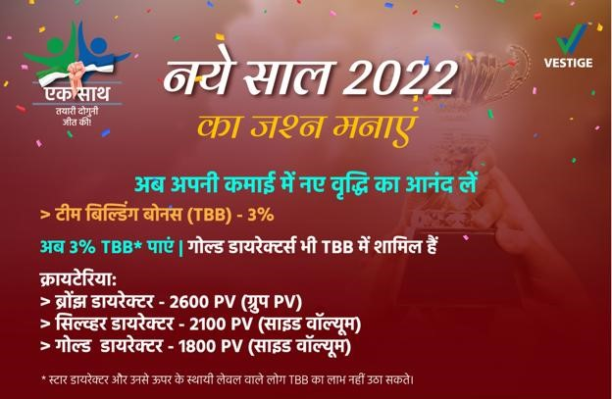
New TBB @3% for Bronze Directors
Bronze Director have to do 2600 PV in a month
11% Leg’s PV will also be add in your qualification
Total PV = 2600
100 PV
BRONZE
PB = 2600x18x4%
= Rs. 1872/-
BDB = 2600x18x6%
= 2808x1.25/-
= Rs. 3510/-
A
C
B
1000 PV
700 PV
800 PV
TBB = 2600x18x6%
= 2808x.90/- = Rs. 2527/-
Total Cheque = 1872+3510+2527 = 7909/-

Slide 9
New TBB @3% for Bronze Directors
Income of Fast Bronze Director by 4500 PV
11% Leg’s PV will also be add in your qualification
Total PV = 4500
300 PV
BRONZE
PB = 4500x18x5%
= Rs. 4050/-
BDB = 4500x18x6%
= 4860x1.25/-
= Rs. 6075/-
A
C
B
1500 PV
1000 PV
1700 PV
TBB = 4860x.90/-
= Rs. 4374/-
Total Cheque = 4050+6075+4374 = 14499/-

Slide 10
New TBB @3% & LOB Effects for Silver Directors
Silver Director have to do 2100 Side PV in a month
11% Leg’s PV will also be add in your qualification
Total PV = 4700
PB = 2100x18x5%
= Rs. 1890/-
SILVER
100 PV
BBB = 2600x18x5% + 2100X18X6%
= 2340+2268 = 4608x0.85/-
= Rs. 3916/-
A
C
B
TBB = 4608x0.90/-
= Rs. 4147/-
2600 PV
800 PV
1200 PV
Total Cheque = 1890+3916+4147 = Rs. 9953/-

Slide 11
New TBB @3% & LOB Effects for Silver Directors
Silver Director have to do 2100 Side PV with 1 LOB in a Month
11% Leg’s PV will also be add in your qualification
Total PV = 7725
SILVER
100 PV
PB = 2100x18x4% = Rs. 1512/-
BBB = 2100X18X6% + 2100x18x5%
+ 3525x4% = 6696x0.85/-
= Rs. 5691/-
A
D
C
2100 PV
800 PV
TBB = 6696x0.90/- = Rs. 6026/-
B
1200 PV
3525 PV
LOB = (7725x5%x18) – 4500 (ULG)
= 2453x2.25/- = Rs. 5519/-
Total Cheque = 1512+5691+6026+5519 = Rs. 18748/-

Slide 12
New TBB @3% & LOB Effects for Silver Directors
Silver Director have to do 2100 Side PV with Multi LOB in a Month
11% Leg’s PV will also be add in your qualification
Total PV = 12100
SILVER
100 PV
PB = 2100x18x4% = Rs. 1512/-
4000 PV
A
BBB = 2100X18X6% + 4000x18x5%
+ 6000x4% = 10188x0.85/-
= Rs. 8660/-
D
B
C
800 PV
TBB = 10188x0.90/- = Rs. 9169/-
6000 PV
1200 PV
LOB = (4500+2100x5%x18 – 4500 (ULG)
= 1890x2.25/- = Rs. 3600/-
Total Cheque = 1512+8660+9169+4252 = Rs. 23593/-

Slide 13
New TBB @3% & LOB Effects for Gold Directors
Gold Director have to do 1800 Side PV with 1 LOB in a Month
11% Leg’s PV will also be add in your qualification
Total PV = 10025
300 PV
GOLD
PB = 1800x18x4% = Rs. 1296
F
BBB = 1800X18X6% + 2100x18x5%
+ 2100x18x5% + 3525x4%
=8712x.85/- = Rs. 7405/-
700 PV
A
C
B
2100 PV
800 PV
TBB = 8712x0.90/- = Rs. 7841/-
E
2600 PV
TF = 8712x0.24/- = Rs. 2091/-
3525 PV
LOB = (5625+1800)x18x5%
7425 – 4500 (UPG) = 2925x2.25/- = Rs.6581 /-
Total Cheque = 1296+7405+7841+2091+6581 = Rs. 25214/-

Slide 14
New TBB @3% & LOB Effects for Gold Directors
Gold Director have to do 1800 Side PV with Multi LOB in a Month
11% Leg’s PV will also be add in your qualification
Total PV = 22000
PB = 1800x18x4% = Rs. 1296
GOLD
300 PV
BBB = 1800X18X6% + 4200x18x5% +
4200x18x4% + 12000x18x3%
= 15228x.85/- = Rs. 12943/-
A
2100 PV
2100 PV
I
300 PV
D
G
700
PV
B
2100 PV
2100 PV
J
200 PV
TF =15228x0.9/- = Rs. 13705/-
E
H
300
PV
C
6000 PV
6000 PV
TBB =15228x0.24/- = Rs. 3655/-
F
LOB = 9000+(1800X5% + 4200x5%) – 4500 ULG
= 9900x2.25/- = Rs. 22275/-
Total Cheque = 1296+12943+13705+3655+22275 = Rs. 53874/-

Slide 15
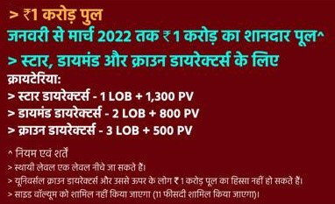
LOB Calculation for Star Directors
Star Director 1001 Side PV with 3 Leg LOB in a Month
11% Leg’s PV will also be add in your qualification
Total PV = 27800
PB = 1300x18x5% = Rs. 1170
STAR
300 PV
BBB = 1300X18X6% + 6800x18x5% +
4200x18x4% + 12000x18x3%
= 17028x.85/- = Rs. 14474/-
A
2100 PV
2100 PV
I
600 PV
D
G
2100
PV
B
2100 PV
2100 PV
J
400 PV
TF =17028x0.24/- = Rs. 4087/-
H
4000
PV
E
CF =17028x0.36/- = Rs. 6130/-
C
6000 PV
6000 PV
F
1% Pool =17028x0.32/- = Rs. 5449/-
LOB = 9000+(1300 + 4200 + 6100)x5%x18 – 4500 ULG
= 14940x2.25/- = Rs. 33615/-
Total Cheque = 1170+14474+4087+6130+5449+33615 = Rs. 64925

Slide 16
LOB Calculation for Diamond Directors
Diamond Director 1001 Side PV with 4 LOB in a Month
11% Leg’s PV will also be add in your qualification
Total PV = 53300
PB = 800x18x5% = Rs. 720
DIAMOND
800 PV
BBB = {800x6%+8400x5%+12300x4%+
14100x3%+18000x2%} x 18
= 31374x.85/- = Rs. 26668/-
A
2100 PV
2100 PV
I
2100 PV
D
G
2100
PV
TF =31374x0.24/- = Rs. 7530/-
B
2100 PV
2100 PV
J
2100 PV
CF =31374x0.36/- = Rs. 11295/-
E
H
6000
PV
1% Pool =32374x0.32/- = Rs. 10040/-
C
6000 PV
6000 PV
F
K
2100 PV
STAR
LOB = 18000+(800+6300+2100)x5%x18
-4500 UPG
= 21780x2.25/- = Rs. 49005/-
L
M
N
6000 PV
6000 PV
6000 PV
Total Cheque = 720+26668+7530+11295+10040+49005 = Rs. 105248/-

Slide 17
LOB Calculation for Crown Directors
Crown Director Side PV with 4 LOB in a Month
11% Leg’s PV will also be add in your qualification
Total PV = 58500
PB = 800x18x5% = Rs. 720
500 PV
P
BBB = {800x6%+13600x5%+8400x4%+
36000x3%} x 18
= 38592x.85/- = Rs. 32803/-
CROWN
2600 PV
O
A
2100 PV
2100 PV
2100 PV
2600 PV
TF =38592x0.24/- = Rs. 9262/-
D
G
J
CF =38592x0.36/- = Rs. 13893/-
B
2100 PV
2100 PV
2100 PV
2100 PV
E
H
1% Pool =38592x0.32/- = Rs. 12349/-
C
6000 PV
6000 PV
6000 PV
HF =38592x0.34/- = Rs. 13121/-
I
K
2100 PV
F
STAR
LOB = 18000+(500+8400)x5%x18-4500 UPG
= 21510x2.25/- = Rs. 48398/-
L
M
N
6000 PV
6000 PV
6000 PV
Total Cheque = 720+32803+9262+13893+12349+13121+48398
= Rs. 130546/-

Slide 18
LOB Calculation for Universal Crown Directors
Universal Crown Director with 5 Legs Multi LOB with Elite Bonus
LOB’s
UCD
Total PV = 304409 PV
L-1 = 5x4500 – 4500 UPG
= 18000 as Upline Guarantee
150000
500
500
Bronze
V
2001
L-2 = (1800+1300+6000)x5%x18
+ 800x3%x18
= 8622
A
B
C
D
E
F
G
H
DCD
SD
Bronze
SD
GD
Bronze
Bronze
UCD
W
Bronze
4000
2001
3000
2001
Bronze
SD
800
d
2001
GD
I
M
SD
GD
CD
L-3 = (2100+3900+12000)x5%x18
= 16200
N
Star
c
Bronze
6000
X
Y
Z
a
b
6000
e
2001
SD
Bronze
Bronze
n
SD
SD
BD
GD
SD
J
K
SD
O
P
Q
f
2001
2001
h
L-4 = (2100+8400)x5%x18
= 9450
GD
o
p
q
r
6000
6000
SD
GD
j
L
R
g
i
SD
SD
SD
6000
SD
SD
s
t
Total LOB = 18000+8622
+16200+9450
= 52272 x 2.25
LOB Income = Rs. 117612/-
6000
S
T
6000
6000
w
x
k
l
2001
u
6000
NOTE -
6000
v
U
6000
6000
y
m
BD=Bronze Dir-6000 PV
6000
6000
6000
SD=Silver Dir-2100 PV
GD=Gold Dir-1800 PV
CD=Crown Dir-800 PV

Slide 19



Lets Create History in Direct Selling through Vestige with WT
I WELCOME YOUR QUESTIONS

